Slide 1
Traffic Calculation
Notes:
This document have the main steps to calculate the GSM traffic.

Slide 2
For this we have to define some parameters
1. Erlang
2. GOS
3. TCH
4.SDCCH
5. Site Type

Slide 3
Erlang
An Erlang is a unit of GSM traffic measurement.
an Erlang represents the continuous use of one voice path.
it is used to describe the total traffic volume of one hour.
Notes:
For example, if a group of user made 30 calls in one hour, and each call had an average call duration of 5 minutes, then the number of Erlangs this represents is worked out as follows:
Minutes of traffic in the hour = number of calls x duration Minutes of traffic in the hour = 30 x 5 Minutes of traffic in the hour = 150 Hours of traffic in the hour = 150 / 60 Hours of traffic in the hour = 2.5 Traffic figure = 2.5 Erlangs
TOTAL traffic assigned per subscriber = 15 m erlangs

Slide 4
GOS (Grade of Service)
GOS means Grade of service
probability of call blocking, probability of call failure.
2% blocking means 2 calls could be blocked out of 100.
Notes:
We set GOS or Blocking = 2% = .02.

Slide 5
TCH
TCH stands for traffic channel
The traffic channel carries speech or data information. The different types of traffic
channel are listed below:
Full rate
TCH/FS: Speech (13 kbit/s net, 22.8 kbit/s gross)
TCH/EFR: Speech (12.2 kbit/s net, 22.8 kbit/s gross)
TCH/F9.6: 9.6 kbit/s – data
TCH/F4.8: 4.8 kbit/s – data
TCH/F2.4 2.4 kbit/s – data
Half rate
TCH/HS: speech (6.5 kbit/s net, 11.4 kbit/s gross)
TCH/H4.8 4.8 kbit/s – data
TCH/H2.4 2.4 kbit/s – data
Notes:
Where
TCH : Traffic Channel
TCH/FS : Full rate speech channel
TCH/EFR : Enhanced full rate speech
TCH/HS : Half rate speech channel
TCH/9.6 : Data channel 9.6 kbit/s
TCH/4.8 : Data channel 4.8 kbit/s
TCH/2.4 : Data channel 2.4 kbit/s

Slide 6
SDCCH
It is also a traffic channel named Stand-alone Dedicated Control Channel.
It supports the transfer of Data to and from the MS during call setup and validation.
Notes:
SDCCH usage per subscriber is approximately 3.56 m erlangs.

Slide 7
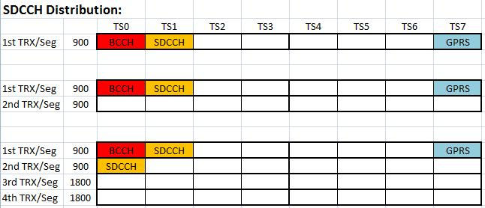
Notes:
For Type2 sites:
One Time slot of first TRX of each segment of 900 for BCCH where BCCH is broadcast control channel. When a subscriber turned on his mobile then it broadcast its information on BCCH. Second Time slot for SDCCH which have been explained before. One for GPRS and remaining are for TCH.
For Type4 Sites:
First Time slot of first TRX of each segment of 900 for BCCH, second for SDCCH and eighth for GPRS.
First Time slot of second TRX of each segment of 900 for SDCCH.

Slide 8
Site Types
We will consider here two types of sites.
Type 2 site
Type 4 site
In case of Type2 sites we have only 900 band.
Each sector have 2 TRX’S means total 6 TRX’s of 3 sectors of a site.
In case of Type4 sites we have 900 and 1800 bands both. Each sector have 4 TRX’s means total 12 TRX’s of 3 sectors of a site.

Slide 9
Procedure For Type2(900 only) sites
For one sector we have
Total no’s of TRX = 2
Which implies TS = 16
From 16 TS one is used for BCCH, then we left 15 TS.
GOS = .02 or 2%
Using erlang Calculator we got 9 erlang traffic.
As we know total traffic allowed/ subscriber is 15merlang. So we can calculate total number of subscriber/sector.
Divide the total erlang i.e. 9erlang/ 15m erlang = 600 subs
Now for all sectors we have 27 erlang traffic and 1800 subs.
To calculate the actual traffic
Actual traffic = total – SDCCH usage
SDCCH traffic = 1800 *3.56 m erlang
= 6.408 erlang
So actual traffic = 27 – 6.408 = 20.59 erlang
Notes:
In case of Type2 Sites Time slot usage is shown in above fig.

Slide 10
Procedure For Type4(900 and 1800) sites
For one sector we have
Total no’s of TRX = 4
Which implies TS = 32
From 32 TS one is used for BCCH, then we left 30 TS.
GOS = .02 or 2%
Using erlang Calculator we got 21.9 erlang traffic.
As we know total traffic allowed/ subscriber is 15merlang. So we can calculate total number of subscriber/sector.
Divide the total erlang i.e 21.9erlang/ 15m erlang = 1460 subs
Now for all sectors we have 65.7 erlang traffic and 4380 subs.
To calculate the actual traffic
Actual traffic = total – SDCCH usage
SDCCH traffic = 4380 *2*3.56 m erlang
= 31.185 erlang
So actual traffic = 65.7 – 31.185 = 34.515 erlang
Notes:
In case of type4 Sites time slot usage is above in fig.

